Slide 1
UNIT- V DISASTER MANAGEMENT
By,
Karthika Kishore Koka
Assistant Professor
Department of Civil Engineering
Chaitanya Bharathi Institute of Technology

Slide 2
Introduction
India vulnerable to natural disasters due its position on the globe
59% of the landmass is prone to earthquakes of various intensities
40 million hectares is prone to floods
5,700 km is prone to cyclones and tsunamis (total= 7500 km)
69% of the area is susceptible to drought
Formation of ISDR (Post IDNDR)
Orissa super cyclone 1989 and Bhuj Earthquake 2001
National Disaster Management Authority (NDMA), GoI

Slide 3
Disaster Management Definition NPDM 2009 and the DM Act 2005
“A continuous and integrated process of planning, organizing, coordinating and implementing measures which are necessary or expedient" for the following:
Prevention of danger or threat of any disaster,
Mitigation or reduction of risk of any disaster or its severity or consequences,
Capacity-building,
Preparedness to deal with any disaster,
Prompt response to any threatening disaster situation or disaster,
Assessing the severity or magnitude of effects of any disaster
Evacuation, rescue and relief, and
Rehabilitation and reconstruction.”

Slide 4
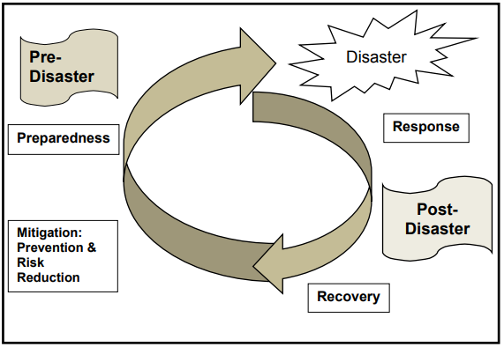
Disaster Management Cycle National Disaster Management Plan (NDMP)

Slide 5
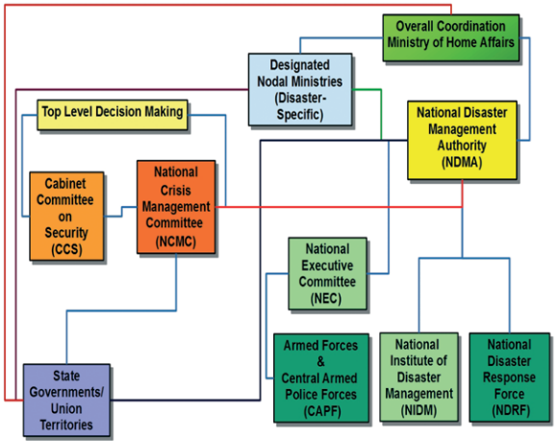
National-level disaster management - basic institutional framework

Slide 6
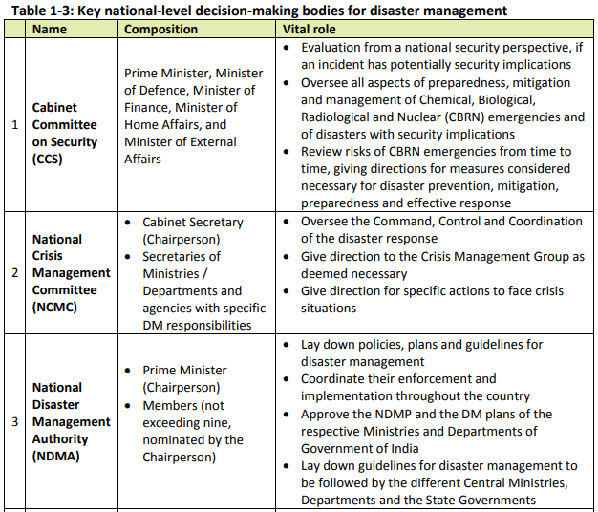

Slide 7
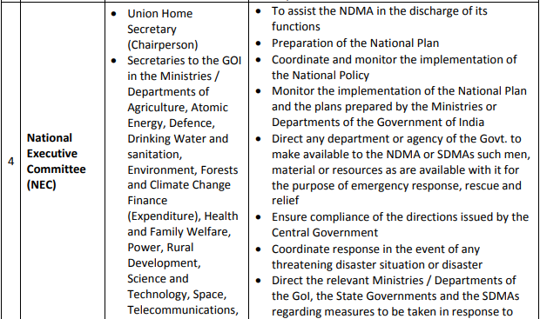

Slide 8
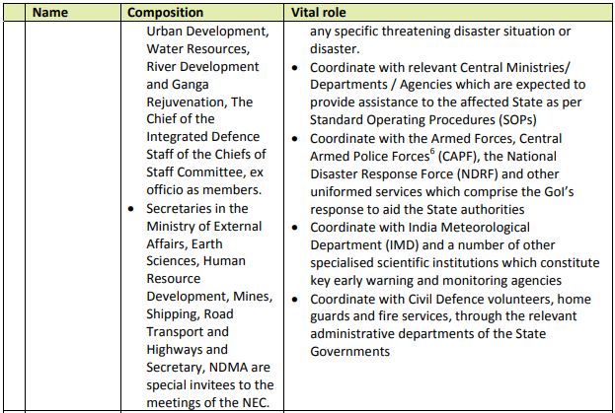

Slide 9
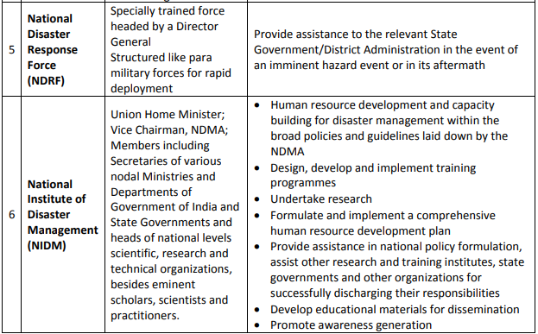

Slide 10
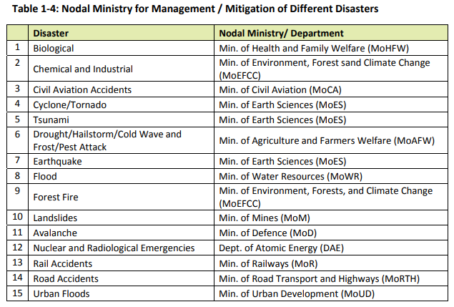

Slide 11
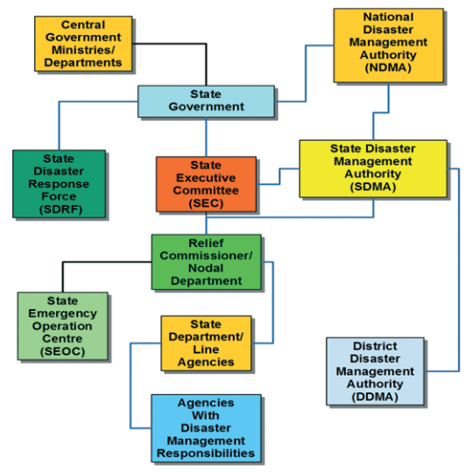
State level disaster management coordination mechanism

Slide 12
Hazard and Disaster
A hazard represents a source of potential damage or loss of life.
A disaster is an event that causes great damage or loss of life.
Eg:
A cruise missile sitting in the hold of a ship is a hazard, but when it detonates it creates a disaster.
Living on the flank of a volcano is hazardous, when it erupts it becomes a disaster.
Therefore, hazard is the potential & disaster is the potential realized.

Slide 13
Vulnerability
Any disaster or hazard is assessed based on its vulnerability and these can be sub divided for easy understanding into various categories such as,
1. Human:
Elderly
Women
Children
Differently abled persons
2. Geographical location
- natural factors
3. Human induced activities
Increasing demographic pressure
Deteriorating environmental conditions
Deforestation
Unscientific developments
Faulty agri practices and grazing
Unplanned urbanization
Construction of large dams

